Slide 1
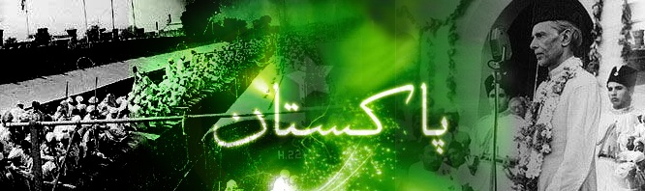
Parliamentary History of Pakistan
By: Jami Chandio

Slide 2
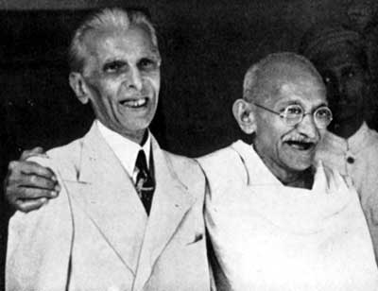
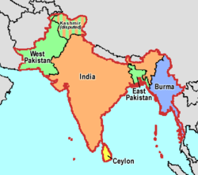
Pakistan was created under Independence Act of 1947, the Act made existing Constituent Assemblies, the dominion legislatures
1947-Independence Act was based on 1935 Indian Act

Slide 3
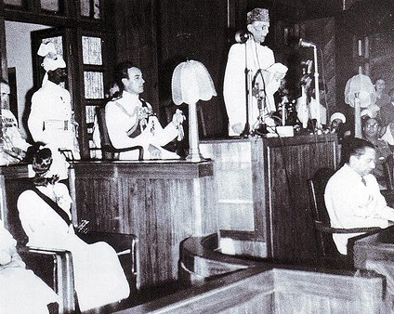
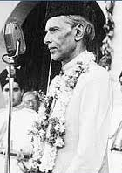
The first session of the first Constituent Assembly was held on 10th August 1947 at Sindh Assembly building Karachi
On 11th August Mr. M A Jinnah was elected unanimously as the president of Constituent Assembly of Pakistan and national flag was formally approved by the Assembly. Mr. Jinnah made his historical speech.

Slide 4
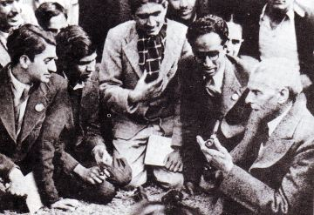
On 12th August a resolution was passed which declared Mr. Jinnah as “ Quaid-e-Azam Mohammad Ali Jinnah”
On the same day a special committee was called the
“ Committee on Fundamental Rights of citizens and minorities of Pakistan” was appointed.

Slide 5
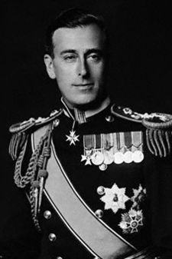
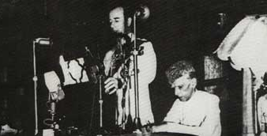
On 14th August 1947, the transfer of power took place and the Governor General of India, Lord Mount Batten addressed the Constituent Assembly of Pakistan.
On 15th August Quaid-e-Azam was sworn in as the first Governor General of Pakistan but he did not amend the interim Constitution which he could have amended as GG. He remained GG till his death i.e. 11th September 1948

Slide 6
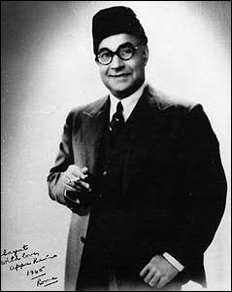
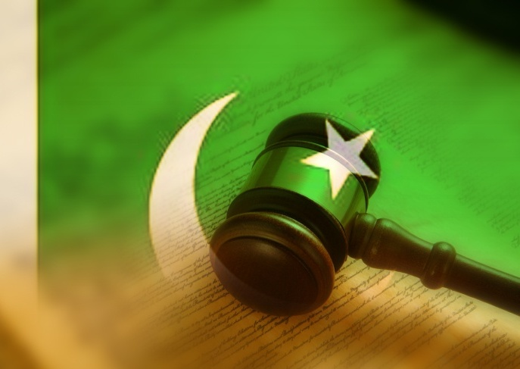
First Constituent Assembly:
The foremost task before the Constituent Assembly was to frame the Constitution
On 7th March 1949, the Objective Resolution, which now serves as the grand norm of Pakistan, was introduced by the first PM of Pakistan, Mr. Liaquat Ali Khan and was later adopted by the Constituent Assembly on 12th March 1949.

Slide 7
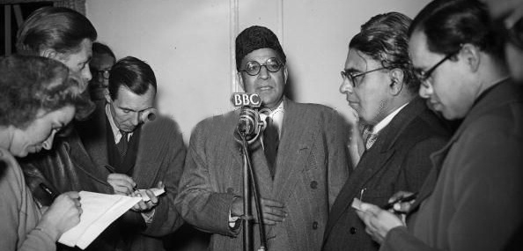
On the same day, a basic principles committee comprised of 24 members was formed to prepare a draft Constitution on the basis of Objectives Resolution

Slide 8
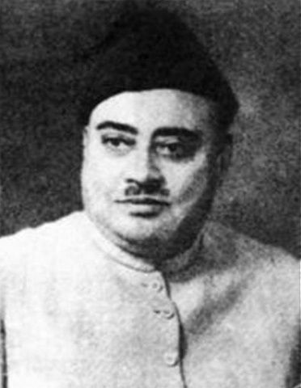
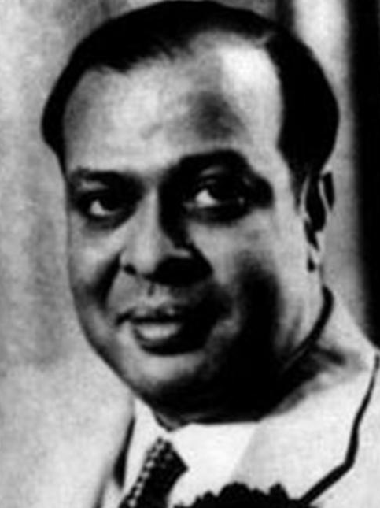
On 16th October 1951, PM Liaquat Ali Khan, mover of the Objective Resolution, was assassinated and Khuwaja Nazimudin took over as the PM on 17th October 1951
The final draft of the Constitution was prepared in 1954, by that time Mohd Ali Bogra had taken over as PM
Khuwaja Nazimudin
Mohd Ali Bogra

Slide 9
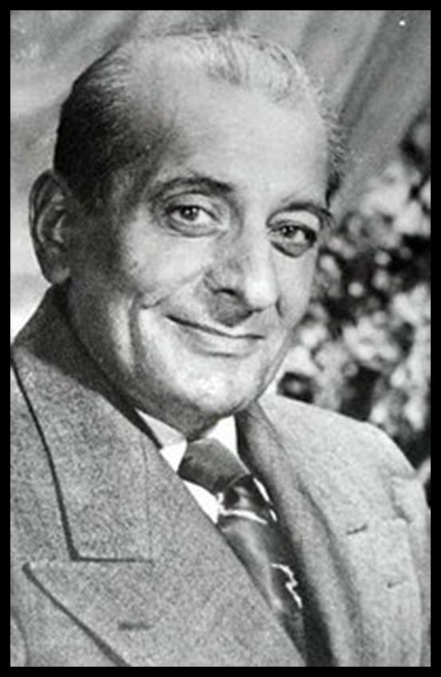
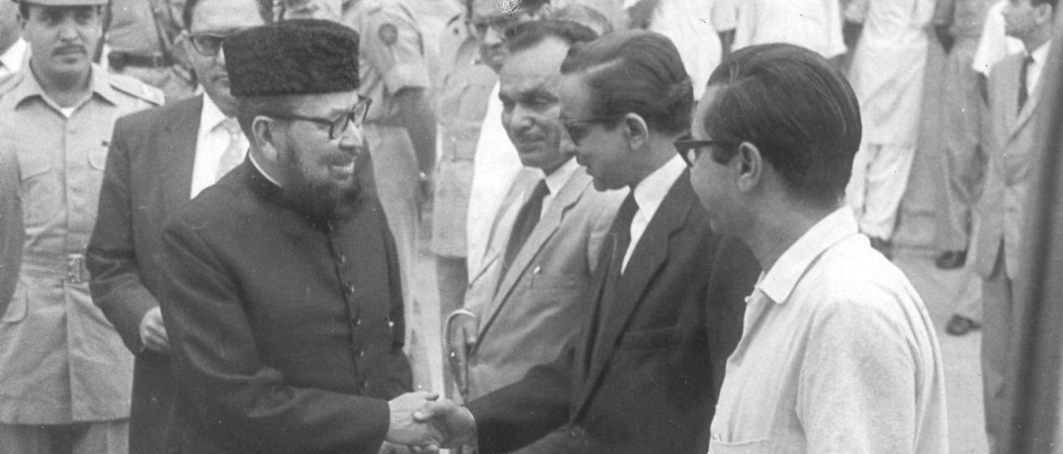
Just before the draft could have been placed in the House for approval , the Assembly was dissolved by the then GG Gulam Mohammad on 24th October 1954. The PM was however not dismissed until elections were held
Moulvi Tamizudin, President of Assembly, challenged the dissolution in the Sindh Chief Court and won the case
Malik Ghulam Muhammad
Moulvi Tamizudin

Slide 10
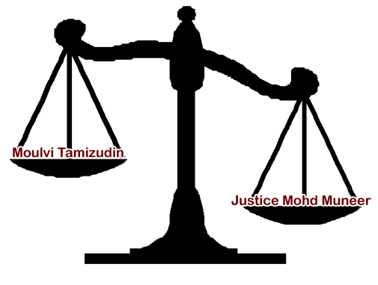
The Government in return, went to the Federal Court, where the famous judgment was given by the then CJ Mohd Muneer, according to which Maulvi Tameezudin lost the case

Slide 11
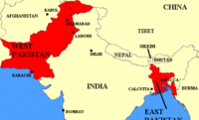
The 2nd Constituent Assembly
The second constituent assembly of Pakistan was created on 28th May 1955 under Governor General’s order no 12 of 1955
The electoral college of this Assembly was the provincial Assemblies of respective provinces and the strength of this assembly was 80 members ( half each from East and West Pakistan)
One unit was created by this assembly on the basis of parity

Slide 12
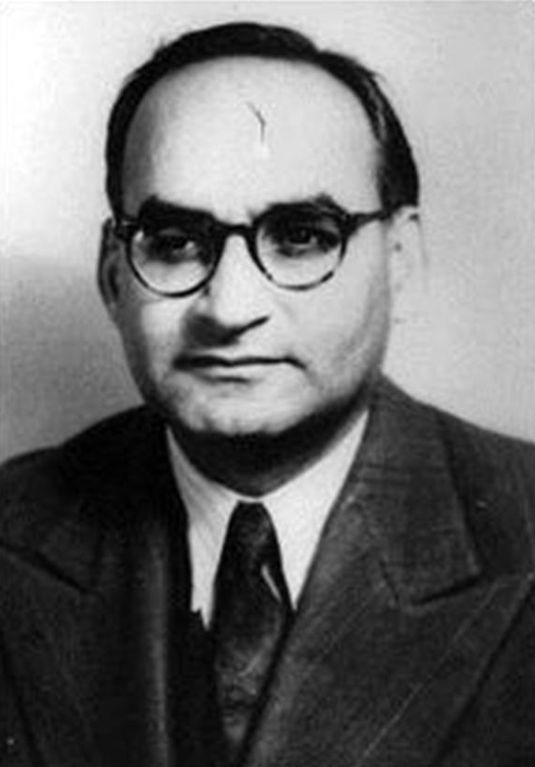
1956 Constitution
Pakistan’s first 1956 Constitution was also given by this Assembly and Chaudhri Mohd Ali was PM at that time
1956 Constitution was enforced with effect from 23rd March 1956
Under this Constitution Pakistan became an Islamic Republic
Chaudhri Mohd Ali

Slide 13
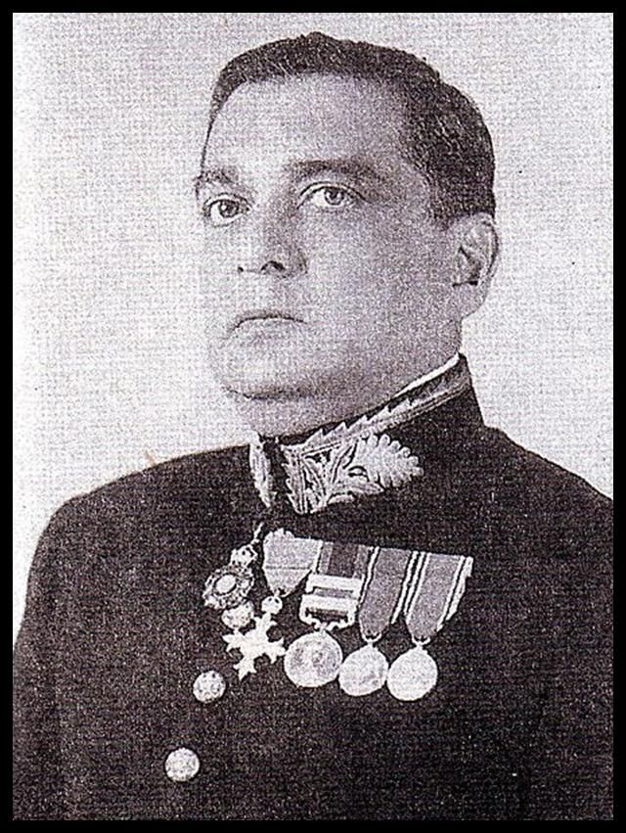
On 5th March 1956 Major General Sikandar Mirza became the first elected President of Pakistan
1956 Constitution provided parliamentary form of Government with all the executive powers in the hand of PM
Sikandar Mirza

Slide 14
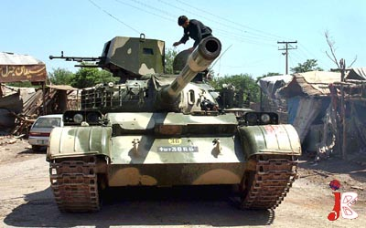
Under 1956 Constitution Parliament was unicameral
When the first general elections were scheduled for early 1959, president Sikandar Mirza abrogated the Constitution, dissolved National and Provincial Assemblies and declared Martial Law on 7th October 1958

Slide 15
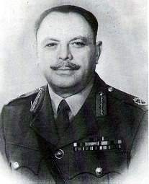
He Appointed General Mohd Ayub Khan Commander –in-Chief of Army as Chief Martial Law Administrator
On 27th October 1958 General Mohd Ayub Khan took over as president of Pakistan and he appointed Constitution commission on 17th Feb 1960 which was aimed to submit proposals for new Constitution based on the “ Islamic principles of justice”
General Mohd Ayub Khan

Slide 16
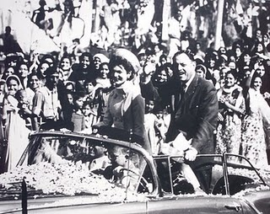

1962 Constitution
The Commission submitted its report on 29th April 1961 and on the basis of this report 1962 Constitution was framed and given on 1st March 1962
General elections under 1962 Constitution were held on 28th March 1962

Slide 17
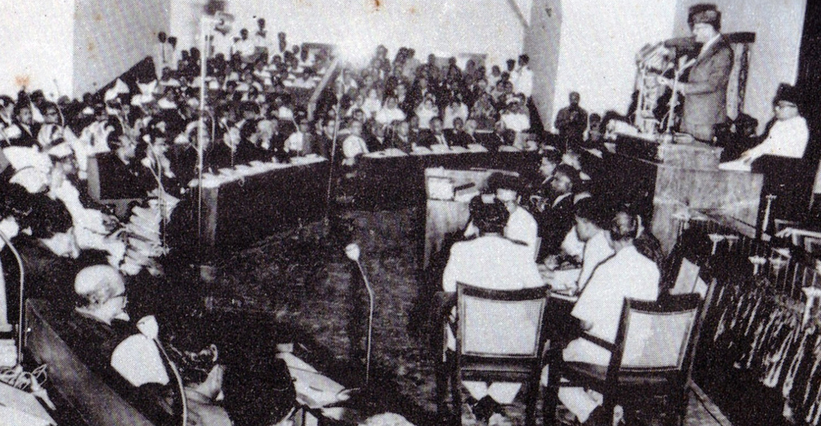
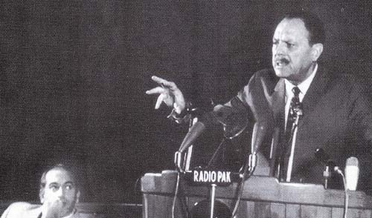
1962 Constitution envisaged a Federal State with Presidential form of Government and unicameral legislature
The electoral system was made indirect, and “basic Democrats” for both wings were declared Electoral Collage for electing the Assemblies and President

Slide 18
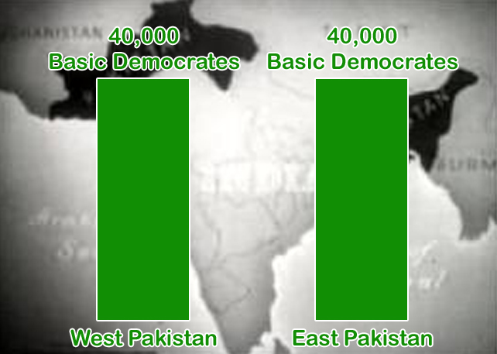
Basic democrats were 80,000 (40,000 from each province)
One of the major initiatives of this assembly was the passage of Political parties Act 1962

Slide 19
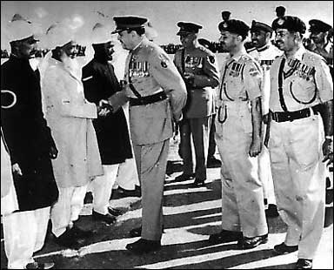
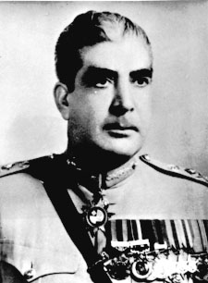
On 25th March 1969 the second Martial Law was imposed and general Aagha Yahya Khan took over as the President and CMLA
CMLA issued LFO under which first ever general elections were held on 7th Dec 1970 and this was first Assembly elected on the basis of adult franchise and population
Aagha Yahya Khan

Slide 20
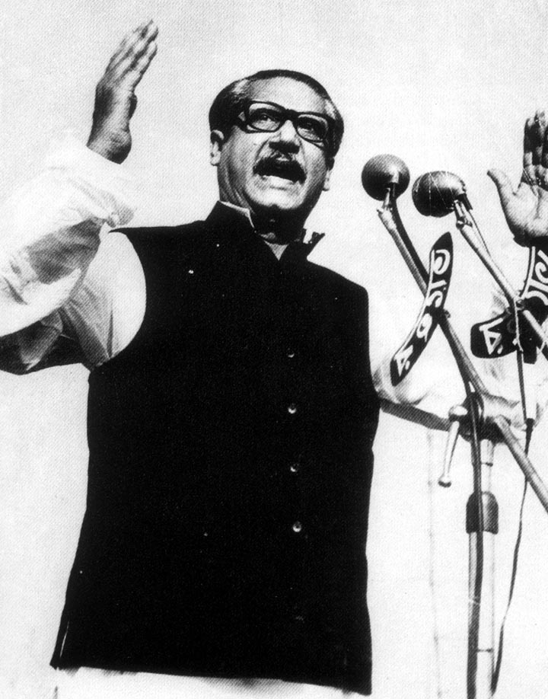
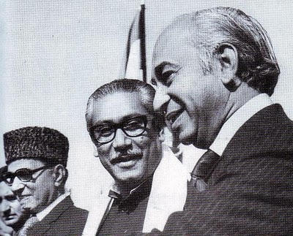
Awami League got majority mandate but their right to form Govt was denied and Mujeeb’s 6 points were rejected which resulted in the debacle of East Pakistan and formation of Bangladesh
On 20th Dec 1971 Z A Bhutto took over as president of Pakistan as well as CMLA
Mujeeb ur rehman

Slide 21
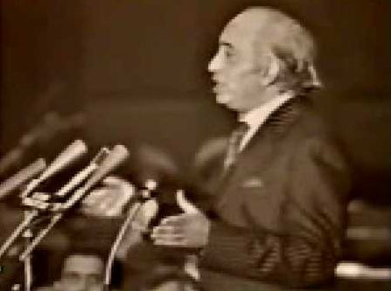
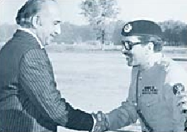
On 17th April 1972 an interim Constitution was adopted by NA which provided Presidential form of Govt.
The assembly formed a Constitution Committee on 17th April 1972 to prepare the draft for new Constitution

Slide 22
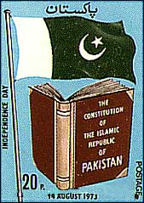
1973 Constitution
1973 Constitution was passed with absolute majority on 10th April 1973 which was promulgated on 14th August 1973 and on same day Z A Bhutto took oath as PM
1973 Constitution provided parliamentary form of Govt with bicameral legislature where as from 1947 to 1973 the country had unicameral legislature

Slide 23
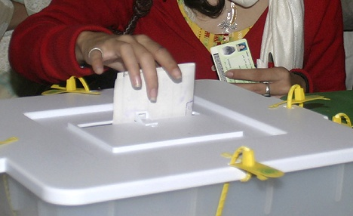
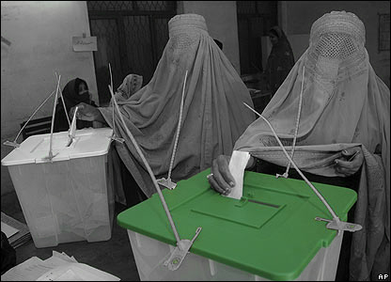
Under 1973 the NA is elected for 5 years but Z A Bhutto on 7th Jan 1977 announced the holding of elections before time
On 10th Jan he advised the President to dissolve NA and elections were held on 7th March 1977
The opposition charged the Govt for rigging in NA elections and boycotted the PA elections

Slide 24
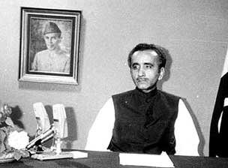
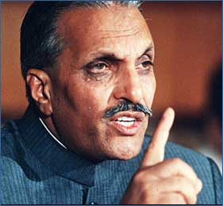
This resulted in severe crisis and Martial law was imposed by the Army chief Zia-ul-Haq on 5th July 1977
On 25th Feb 1985 elections for NA and PA were held on the basis of non-party basis
Mr. Mohd Khan Junejo became PM and received vote of confidence on 24th March 1985
Muhammad Khan Junejo
Zia-ul-Haq

Slide 25
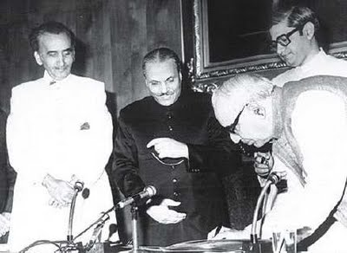
In Nov 1985 Constitutional amendment was adopted by the parliament according to which the President got discretionary powers [58(2)(b)]to dissolve the NA and PA
Junejo Govt was dismissed by gen Zia-ul-Haq under 58(2)(b)

Slide 26
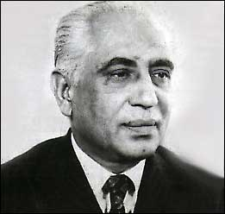
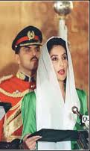
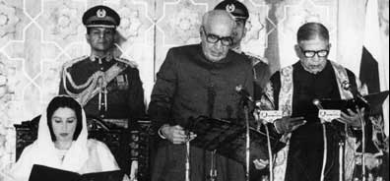
Miraj Khalid
The general elections for the eighth NA was held on 24th October 1988 and Mr. Miraj Khalid was elected as speaker and Mohtarma Benazir Bhutto was nominated as PM. She took oath on 2nd Dec 1988
The assembly was dissolved by the President Ghulam Ishaq Khan on 6th August 1990

Slide 27
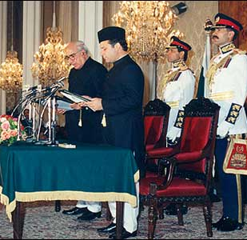
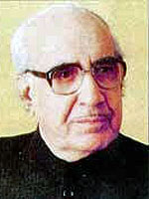
The general elections for the ninth NA was held on 24th October 1990 and Mian Nawaz Sharif took over as PM on 11th Nov
The assembly was again dissolved by President Ghulam Ishaq Khan on 18th April 1993
Ghulam Ishaq Khan

Slide 28
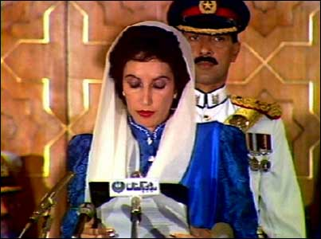
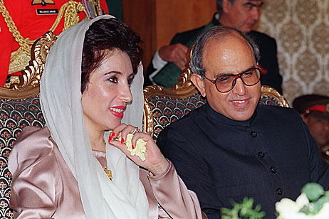
The dissolution of NA was challenged in the supreme Court and was restored by the apex court on 26th May 1993
The assembly was dissolved on the advice of PM on 18th July 1993
The elections for 10th NA was held on 6th October 1993 and Mohtarma BB became PM again

Slide 29
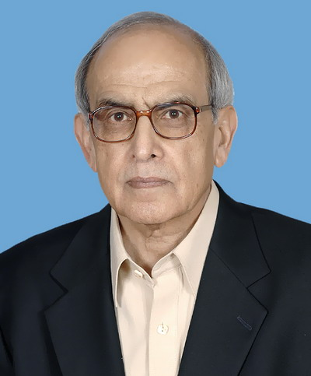
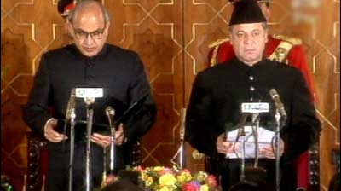
Farooq Ahmed Khan Laghari
The assembly was dissolved by the President Farooq Ahmed Khan Laghari on 5th Nov 1996
The elections for 11th NA was held on 3rd Feb 1997 and Mian Nawaz Sharif became PM again on 17th Feb 1997

Slide 30
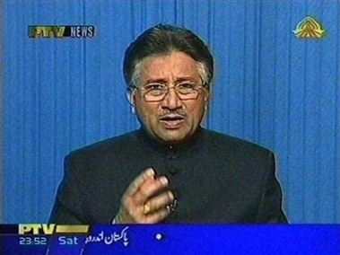
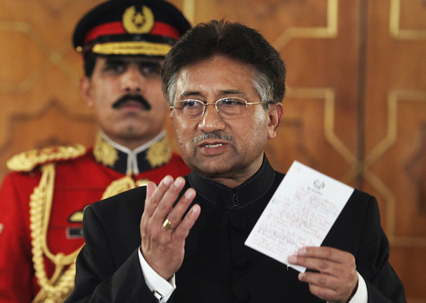
The article 58(2)(b) was omitted from the Constitution through 13th Amendment in April 1997
Chief of Army Staff General Pervez Musharaf toppled the Govt of Mr Sharif and declared himself as Chief Executive through proclamation of Emergency on 12th Oct 1999.

Slide 31
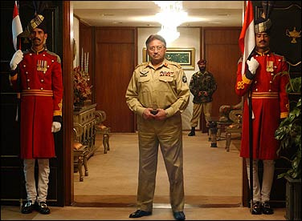
Through PCO issued on October 14th 1999, he held Constitution in abeyance , suspended the Senate, Speaker, Deputy Speaker, NA and PAs and dismissed Central and provincial Govts.

Slide 32
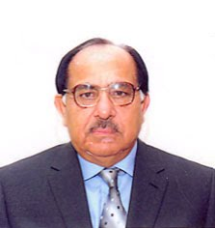


Syed Zafar Ali Shah Ilahi Bux Soomro
Syed Zafar Ali Shah and Speaker Ilahi Bux Soomro challenged the suspension orders in the Supreme court but the Court in its judgment on 12th May validated the military take over by giving three years time frame to the Govt starting from 12th Oct 1999

Slide 33

The Court also allowed the Govt to bring necessary Constitutional Amendments but in accordance with Parliamentary democracy and Islamic principles

Slide 34

On 20th June 2001 through a notification the CE assumed the office of the President of Pakistan under President’s succession Order 2001

Slide 35


On 10th Sept 2007, Nawaz Sharif returned from exile to Islamabad. He was prevented from leaving the plane and he was deported to Jeddah, Saudi Arabia.
Though on 25 November 2007, Sharif returned to Pakistan

Slide 36


Benazir Bhutto Returned to Pakistan on 18th Oct 2007, facing two bomb blasts at Karsaz.
On 8th Nov she was placed under house arrest for one day.

Slide 37



General Elections held on Jan 8th 2008.
Benazir Bhutto Assassinated after address to party supporters at Liaquat National Bagh, Rawalpindi.
Country fell into uncontrollable riots.
Elections Postponed up to February 18th 2008.

Slide 38


Peoples party formed coalition government. On 25th March Yousif Raza Gilani took as PM.
Asif Ali Zardari Elected as president of pakistan on 9th Sep 2008.

Slide 39




Parliament passed 18th amendment.
Shift of Power took place powers from house of president shifted to parliament.

